Slide 1
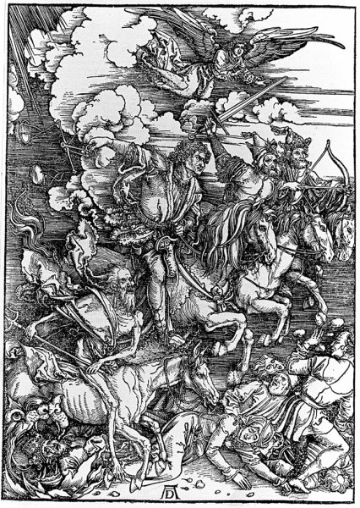
The Research Skills exam:
The four horsemen of the apocalypse: pestilence, war, famine and the RS1 exam.

Slide 2
What to expect…
Week 11
Structure of exam
Revisiting the flowcharts
Section 1 & 3 of the Mock Exam
Week 12:
Sections 5, 4, & 2 of the Mock Exam

Slide 3
The exam format:
Two hours and five sections –
Section 1: basic concepts
Section 2: interpreting SPSS output.
Section 3: which test?
Section 4: pick a test and conclusions
Section 5: write a results section

Slide 4
Be strategic:
Don’t start at page 1 and work through. Each section carries equal marks.
Answer all the easy questions first! Then tackle tricky stuff if there is time left.

Slide 5
Two flow charts
See Graham’s website…

Slide 6
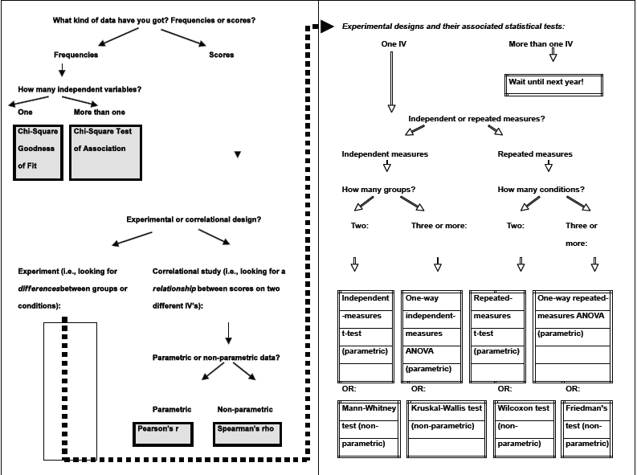

Slide 7
PARAMETRIC OR NOT?
Data type
Ratio
Interval
Ordinal
Nominal
Homogeneity of variance?
NON-PARAMETRIC
SD²1/SD²2
≤ 2
SD²1/SD²2
> 2
Normal distribution?
PARAMETRIC
Yes
No

Slide 8
Tips to remember which test…
Frequencies = Chi-square
Looking at relationships = correlational
Looking at differences = experimental

Slide 9
Tips to remember which test…
Correlational – parametric & non-parametric
Pearson’s = parametric
Spearman’s = the other one
Notes:
Students may have their own methods for remembering these…

Slide 10
Tips to remember which test…
Experimental – parametric
Independent-measures t-test – independent measures design
Repeated-measures t-test – repeated measures design
Notes:
These test names are pretty self-explanatory.

Slide 11
Tips to remember which test…
Experimental – non-parametric, 2 conditions
Mann-Whitney – 2 different types of name, so independent
Wilcoxon – the other one, i.e., repeated
Notes:
Mann-Whitney - two different types of name:
‘Mann’ – like man
‘Whitney’ – woman’s name, so different to ‘man’.
They’re independent!

Slide 12
Tips to remember which test…
Experimental – non-parametric, 3 or more conditions
Kruskal-Wallis – independent design
Friedman’s – repeated design
Notes:
Maybe ask students how they could remember these…

Slide 13
Section 1: Basic concepts
Ten multiple choice questions, testing knowledge of basic statistical concepts.
Revise by writing clear definitions of terms such as "mean", "standard deviation", "normal distribution", "ratio data", "one-tailed test", etc.
Read all of the five alternatives carefully, before making your choice.

Slide 14
1. The Standard deviation is:
(a) a statistic that tells us how well our sample mean is likely to reflect the true, population, mean.
(b) a statistic that tells us how scores are distributed around the mean of the set of scores.
(c) a statistic that tells us whether scores are normally distributed.
(d) a statistic that tells us what is the most commonly-occurring value in a set of scores.
(e) none of the above.
Correct definition
[ b ]

Slide 15
2. If the null hypothesis is true, then p < .05 means:
(a) the obtained result is not due to chance.
(b) the obtained result is a fairly important effect.
(c) the obtained result is likely to occur by chance 95% of the time.
(d) the obtained result is likely to occur by chance less than 5 times in a hundred.
(e) the obtained result is likely to occur by chance 5 times in a hundred.
Correct definition:
[ d ]

Slide 16
Section 2: Interpreting SPSS output:
Two parts: in each, you get SPSS output from a study, and 10 questions to answer about it.

Slide 17
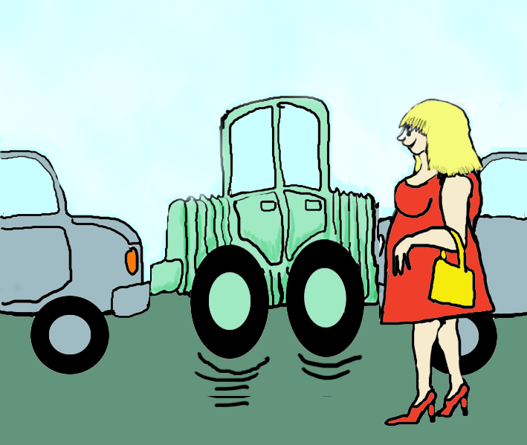
Are there sex differences in car parking ability?
An experimenter times how fast 9 women and 9 men can park their car. The data do not show homogeneity of variance.

Slide 18
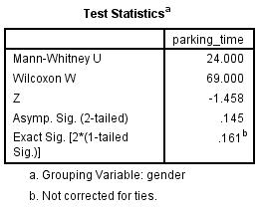
1. Which is the most appropriate statistical test to perform on these data?
(a) Wilcoxon matched-pairs test
(b) Mann-Whitney test
(c) Spearman's correlation test
2. The test results shown in the "Test Statistics“ table are all:
(a) Statistically significant at p < .05
(b) Statistically significant at p > .05.
(c) Not statistically significant at
p < .05

Slide 19
1. Which is the most appropriate statistical test to perform on these data?
(a) Wilcoxon matched-pairs test
(b) Mann-Whitney test
(c) Spearman's correlation test.
2. The test results shown in the "Test Statistics“ table are all:
(a) Statistically significant at p < .05
(b) Statistically significant at p > .05
(c) Not statistically significant at
p < .05

Slide 20
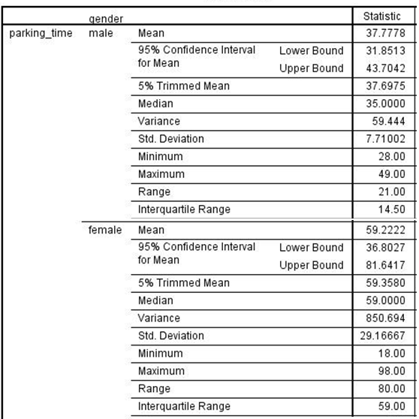
3. The standard error for the male group is:
2.57 (=7.7/√9)
b) 7.71
c) 59.44
d) 29.17
4. The standard deviation for the female group is:
2.57
7.71
59.44
29.17

Slide 21
3. The standard error for the male group is:
2.57 (=7.7/√9)
b) 7.71
c) 59.44
d) 29.17
4. The standard deviation for the female group is:
2.57
7.71
59.44
29.17

Slide 22
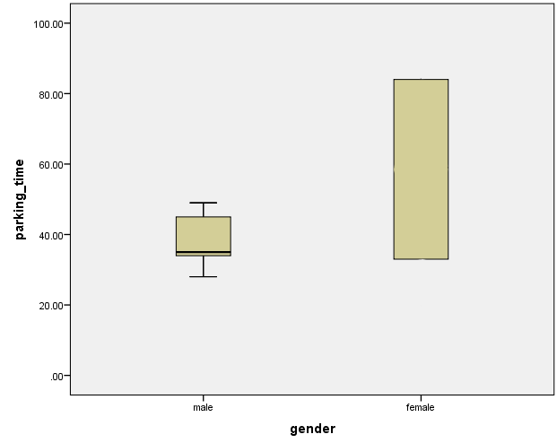
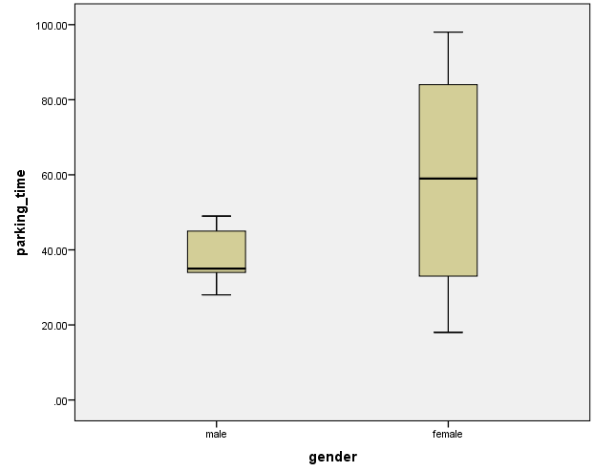
5. Complete the boxplot, using the data from the “descriptives” table.
(Here, add median, and upper and lower whiskers representing the range).

Slide 23
Section 3: Which test:
10 questions. Each gives a brief description of a study that contains enough information for you to work out which test has been performed.
Only ONE of the following tests will be correct:
A. Wilcoxon | B. Spearman’s rho
C. Friedman's | D. Pearson’s r
E. Mann-Whitney | F. Chi-Squared
G. Kruskal-Wallis

Slide 24
1. The statistics exam scores of three groups of students were recorded: group A had revised for 5 hours, group B for 10 hours and group C for 20 hours. The data do not show homogeneity of variance. What test is required to test the hypothesis that revision time affects exam performance?
Test: [G (Kruskal-Wallis]
2. The number of students passing or failing a statistics exam in each of three groups of students was recorded: group A had revised for 5 hours, group B for 10 hours and group C for 20 hours. What test is required to test the hypothesis that revision time affects exam performance?
Test: [F (Chi-square]

Slide 25
Section 4: Pick a test and conclusions
Here are the instructions for this section:
In the following questions you are given some details of an experiment, the results of a number of statistical tests, and a set of conclusions. Only ONE of these tests is appropriate, and only ONE in each set of conclusions is correct. Thus only TWO of the statements are correct in each of the following questions. Indicate which two are correct by writing the appropriate letters in the table at the end of this section.
Look at the data; select the most appropriate test statistics; pick the correct conclusion for those results.

Slide 26
A researcher is interested in whether a drug affects appetite in rats. Eight rats were tested twice, once with the drug and once without the drug, in a random order. In order to feed, the rats need to climb a slope to get a food pellet, and the number of times each animal climbed the slope in a 5-minute period was recorded. The data are not normally distributed.
Drug: | No drug:
10 | 15
15 | 22
11 | 18
22 | 24
18 | 19
14 | 22
16 | 19
19 | 23
M = 15.62 | M = 20.25
SD = 4.03* | SD = 3.01*
Statistical tests:
Mann Whitney U (8,8) = 11.00, p = .03
(b) Pearson’s r = .77, p = .02
(c) Spearman's rho = .80, p = .02
(d) Wilcoxon test: z = 2.52, p = .01
Conclusions:
(e) The drug makes rats’ performance more variable
(f) Rats climb the slope significantly faster after taking the drug
(g) Rats climb the slope significantly more often after taking the drug
(h) Rats climb the slope significantly less often after taking the drug
*using n-1 SD formula

Slide 27
A researcher is interested in whether a drug affects appetite in rats. Eight rats were tested twice, once with the drug and once without the drug, in a random order. In order to feed, the rats need to climb a slope to get a food pellet, and the number of times each animal climbed the slope in a 5-minute period was recorded. The data are not normally distributed.
Drug: | No drug:
10 | 15
15 | 22
11 | 18
22 | 24
18 | 19
14 | 22
16 | 19
19 | 23
M = 15.62 | M = 20.25
SD = 4.03* | SD = 3.01*
Statistical tests:
Mann Whitney U (8,8) = 11.00, p = .03
(b) Pearson’s r = .77, p = .02
(c) Spearman's rho = .80, p = .02
(d) Wilcoxon test: z = 2.52, p = .01
Conclusions:
(e) The drug makes rats’ performance more variable
(f) Rats climb the slope significantly faster after taking the drug
(g) Rats climb the slope significantly more often after taking the drug
(h) Rats climb the slope significantly less often after taking the drug
*using n-1 SD formula

Slide 28
Section 5: Write a results section
Read the scenario supplied; write a results section; interpret the results appropriately:
The hypothesis is that revision combined with alcohol leads to better exam performance than revision alone. This was assessed by measuring participants' exam performance, after either 1) subjects had revised for 5 hours a week while drinking 500 ml of gin; or 2) simply revising for 5 hours each week. The results in terms of the exam scores are shown in the table below, together with the means, standard deviations, and results of the Mann-Whitney test used to compare the scores.
Revision | Revision + gin
5 | 9
14 | 7
13 | 6
17 | 15
12 | 5
11 | 6
19 | 12
11 | 13
M =12.75 | M = 9.13
SD = 4.23* | SD = 3.76*
(NB: maximum exam score is 20).
U(8, 8) = 18.50, p = .161

Slide 29
(a) Graph the data in a form appropriate for inclusion in a lab report:
This doesn’t have to be a work of art, but should be clear and labelled correctly. Include error bars and a title! Standard error = SD divided by square root of the number of subjects. Here, SEs are 1.40 (4.23 / square root of 8) for the sober revisers and 1.24 (3.76 / square root of 8) for the boozed ones.

Slide 30
(b) Describe the data in a form appropriate for inclusion in the results section of a lab report (assuming no graph in the results section).
“A Mann-Whitney test was performed on these data. This revealed that there was no significant difference between the mean exam scores of subjects who combined revision with alcohol consumption (M = 9.12, SE = 1.33 sec) and those who revised without it (M = 12.75, SE= 1.50 sec), U(8, 8) = 18.50, p > .05. Exam performance is not significantly enhanced by combining revision with alcohol consumption."

